Slide 1




GOVT_DATA-SET voice call quality experiences from various customers in August 2018.
Dataset source url: www.data.gov.in
kunduruchandana25@gmail.com
https://www.linkedin.com/in/kunduru-chandana-283938307/
voice call quality experiences from various customers in August 2018.csv

Slide 2
Dataset Overview
This dataset records voice call quality experiences from various customers in August 2018.
It contains 44,622 entries and 8 columns, capturing details about mobile network performance.
Key Attributes:
Operator: Name of the telecom provider (e.g., Airtel, Jio, Vodafone).
Network Type: Type of network used (e.g., 3G, 4G).
Call Rating: Quality rating of the call (on a scale from 1 to 5).
Call Drop Category: Reason for call quality issues (e.g., Call Dropped, Poor Voice Quality).
Location Data: Includes Latitude, Longitude, and State Name.
Usage Scenario: Whether the call was made indoor, outdoor, or while traveling.
The dataset helps in analyzing:
Call quality variations across different operators.
Impact of network type on call experience.
Geographic trends in call drops and poor voice quality.

Slide 3
Data Structure & Columns
Column Name | Description
Operator | Name of the telecom operator (e.g., Airtel, Jio, Vodafone).
In Out Travelling | Whether the call was made Indoor, Outdoor, or While Traveling.
Network Type | The type of network used (e.g., 3G, 4G, Unknown).
Rating | Call quality rating (integer scale from 1 to 5).
Call Drop Category | Describes the call issue (Call Dropped, Poor Voice Quality, Satisfactory, etc.).
Latitude | Geographical latitude of the call location.
Longitude | Geographical longitude of the call location.
State Name | The state where the call took place.

Slide 4
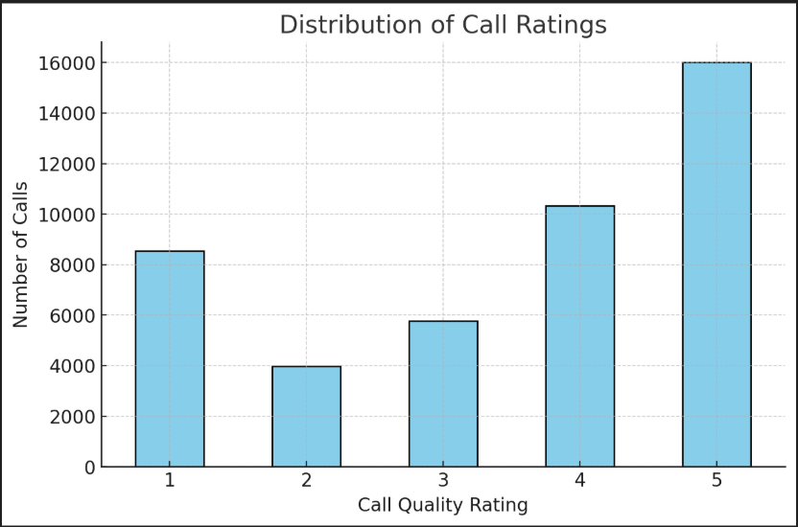
Distribution of Call Ratings
import pandas as pd
import seaborn as sns
import matplotlib.pyplot as plt
# Load the dataset
df = pd.read_csv("your_dataset.csv")
# Plot distribution of Call Ratings
plt.figure(figsize=(8,5))
sns.histplot(df['Call_Rating'], bins=10, kde=True, color='blue')
plt.title('Distribution of Call Ratings')
plt.xlabel('Call Rating')
plt.ylabel('Frequency')
plt.show()

Slide 5
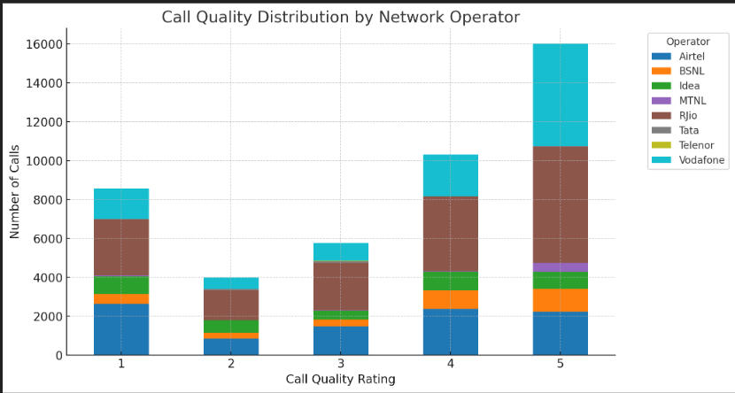
Call Quality by Network Operator
plt.figure(figsize=(10,6))
sns.boxplot(x='Network_Operator', y='Call_Quality_Score', data=df, palette='Set2')
plt.title('Call Quality by Network Operator')
plt.xlabel('Network Operator')
plt.ylabel('Call Quality Score')
plt.xticks(rotation=45)
plt.show()

Slide 6
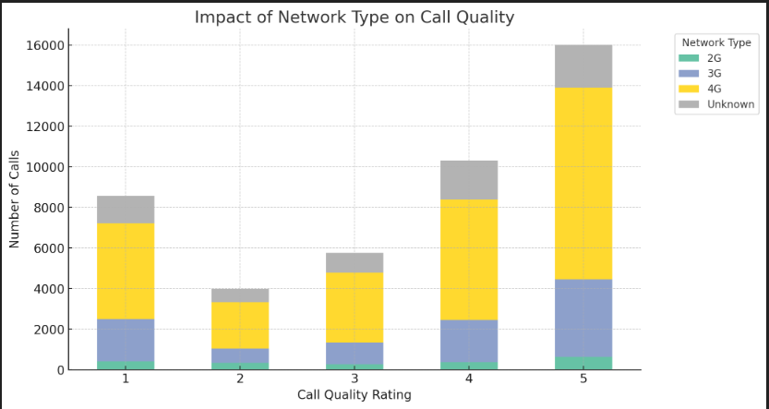
Impact of Network Type on Call Quality
plt.figure(figsize=(8,5))
sns.boxplot(x='Network_Type', y='Call_Quality_Score', data=df, palette='coolwarm')
plt.title('Impact of Network Type on Call Quality')
plt.xlabel('Network Type (2G/3G/4G/5G)')
plt.ylabel('Call Quality Score')
plt.show()

Slide 7
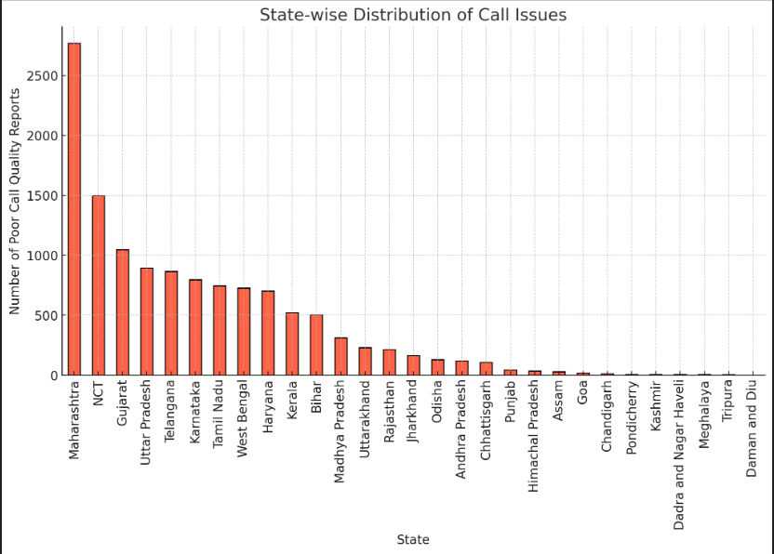
Geographic Distribution of Call Issues
import geopandas as gpd
# Convert latitude and longitude to a GeoDataFrame
gdf = gpd.GeoDataFrame(df, geometry=gpd.points_from_xy(df.Longitude, df.Latitude))
# Plot call issues geographically
world = gpd.read_file(gpd.datasets.get_path('naturalearth_lowres'))
fig, ax = plt.subplots(figsize=(10,6))
world.plot(ax=ax, color='lightgrey')
gdf.plot(ax=ax, markersize=10, color='red', alpha=0.6)
plt.title('Geographic Distribution of Call Issues')
plt.show()

Slide 8
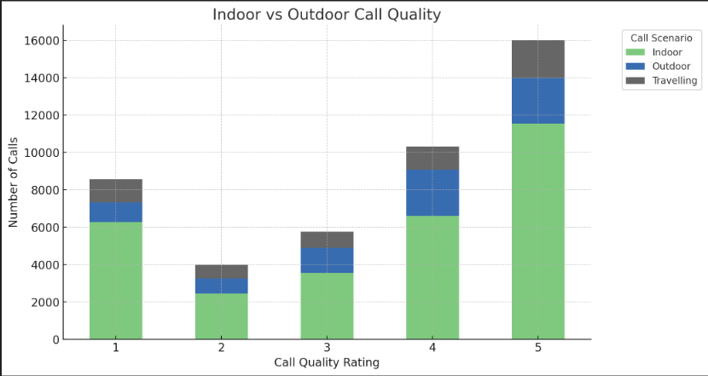
Indoor vs Outdoor Call Quality
plt.figure(figsize=(8,5))
sns.boxplot(x='Call_Location', y='Call_Quality_Score', data=df, palette='coolwarm')
plt.title('Indoor vs Outdoor Call Quality')
plt.xlabel('Call Location (Indoor/Outdoor)')
plt.ylabel('Call Quality Score')
plt.show()

Slide 9
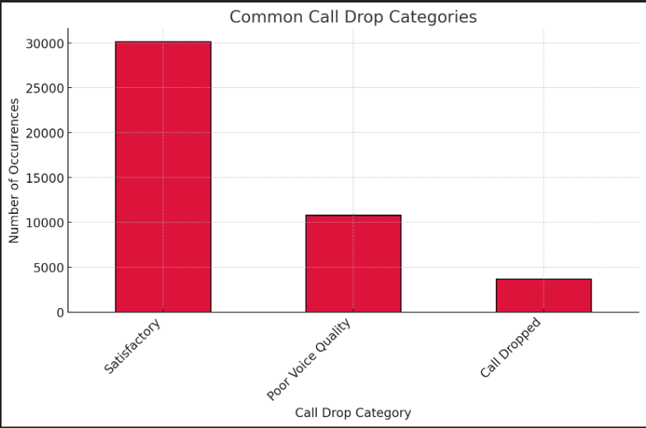
Common Call Drop Categories
plt.figure(figsize=(10,6))
df['Drop_Category'].value_counts().plot(kind='bar', color='purple')
plt.title('Common Call Drop Categories')
plt.xlabel('Drop Category')
plt.ylabel('Frequency')
plt.xticks(rotation=45)
plt.show()

Slide 10
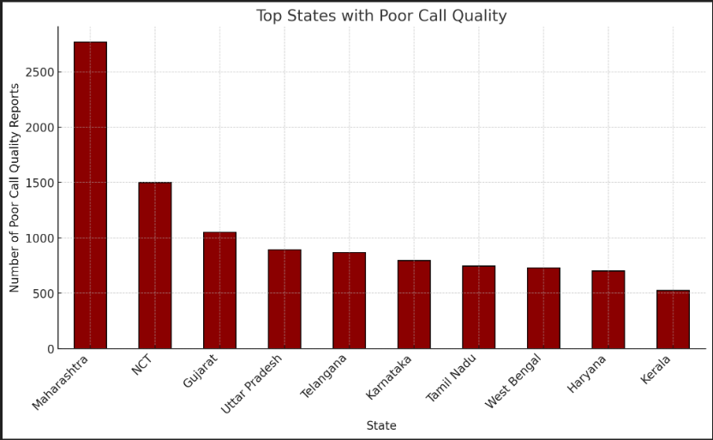
Top States with Poor Call Quality
state_quality = df.groupby('State')['Call_Quality_Score'].mean().sort_values()
plt.figure(figsize=(12,6))
state_quality.head(10).plot(kind='barh', color='red')
plt.title('Top States with Poor Call Quality')
plt.xlabel('Average Call Quality Score')
plt.ylabel('State')
plt.show()

Slide 11
Summary of Findings
Call Rating Distribution:
Majority of calls received satisfactory ratings (3-5).
A significant portion reported poor call experiences (1-2 ratings).
Call Quality by Network Operator:
Some operators showed better ratings than others, highlighting areas for improvement.
Impact of Network Type on Call Quality:
4G networks generally performed better than 2G and 3G in call ratings.
Geographic Distribution of Call Issues:
States like Maharashtra, Delhi, and Gujarat had higher reports of poor call quality.
Indoor vs Outdoor Call Quality:
Indoor calls had more issues compared to outdoor calls due to network coverage limitations.
Common Call Drop Categories:
Poor voice quality and network congestion were the top reasons for call drops.

Slide 12
Recommendations for Improvement
Expand Network Coverage
Strengthen infrastructure in low-quality regions (e.g., rural areas, high-density urban zones).
Improve Indoor Call Quality
Invest in signal boosters and Wi-Fi calling support for better indoor connectivity.
Optimize Network Congestion
Enhance bandwidth allocation to handle peak usage times.
Encourage 4G/5G Adoption
Promote transition from 2G/3G to 4G/5G for improved voice clarity.
Customer Support & Issue Resolution Introduce real-time troubleshooting tools in mobile apps.

Slide 13
Challenges & Limitations
Network Infrastructure Constraints
Device & Technology Compatibility
Environmental & Geographic Barriers
Data Accuracy & User-Reported Issues
Cost & Implementation Challenges
Improving call quality requires addressing both technical limitations and user experience factors, while balancing cost and feasibility.

Slide 14
Future Scope
5G & Next-Gen Network Expansion
AI-Driven Call Quality Optimization
Enhanced Coverage & Infrastructure
Improved Call Analytics & User Feedback Integration
Integration of IoT & Smart Connectivity
The future of call quality lies in AI-driven enhancements, advanced network technologies, and infrastructure improvements to ensure seamless communication experiences.

Slide 15
Conclusion
1. Call Quality Insights:
Analysis reveals persistent call drops in specific regions due to network congestion, poor coverage, and technical failures.
2. Top Impacted Areas:
Certain states and cities report high drop rates and poor call clarity.
3. Improvement Scope:
5G expansion, AI-driven optimization, and infrastructure upgrades can reduce call drops and improve reliability.

